Slide 1
PC Maintenance: Preparing for A+ Certification
Chapter 15: Video Cards

Slide 2
Chapter 15 Objectives
Understand video resolution and color depth
Identify video card interfaces
Calculate amount of video RAM required
Understand 3D acceleration and APIs
Install a video card
Set up video driver in Windows
Troubleshoot video problems

Slide 3
Video Card Concepts
Acts as a hardware interface between monitor and PC
Has its own chipset and RAM, like a motherboard
Talks to the OS via a driver

Slide 4
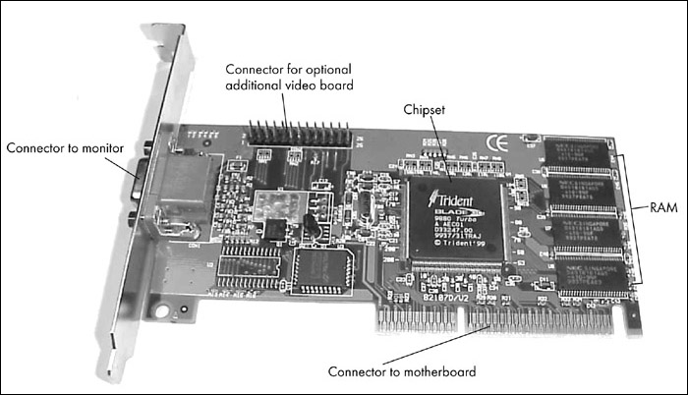
Video Card Concepts

Slide 5
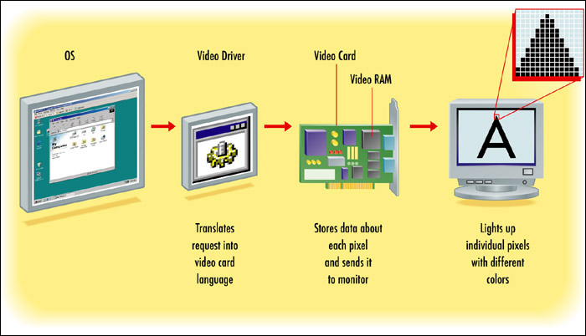
Video Card Concepts

Slide 6
Video Resolution
Pixels: Individual dots in a particular display resolution
Examples:
  640x480
  800x600
  1024x768

Slide 7
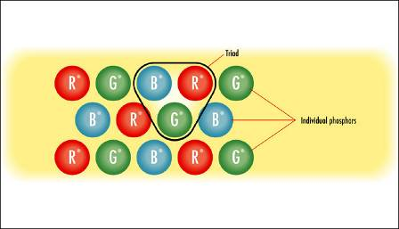
Monitor Resolution
Triad: One set of one red, one green, one blue phosphor
Number of triads per pixel depends on display resolution chosen in OS

Slide 8
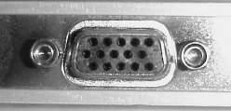
Video Card Interfaces
VGA:
  Standard interface for over a decade
  Interfaces with analog monitors
DV-I:
  New, all-digital interface
  Interfaces with digital LCD monitors only

Slide 9
Video Card Types
PCI Express:
  New type of motherboard slot in 2004
  Faster than AGP
AGP:
  AGP slot on motherboard designed specifically for video card
  Fast interface

Slide 10
Video Card Types
PCI:
  Multi-purpose interface on motherboard
  Not as fast as AGP
  Useful for systems with multiple video cards, since only one can be AGP

Slide 11
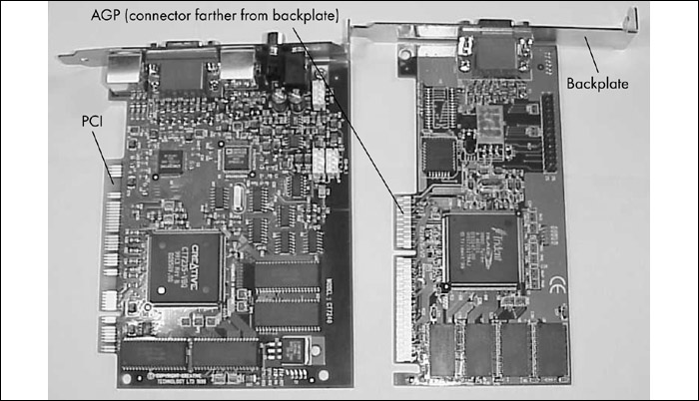
Video Card Types

Slide 12
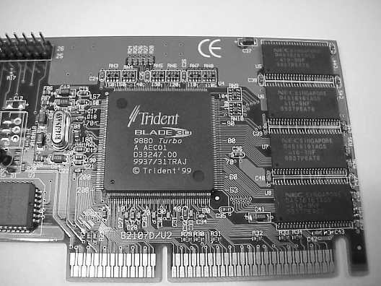
Video Chipset
Not always the same brand as the video card itself
Determines overall driver class compatibility

Slide 13
Video RAM
How Much RAM needed for a particular resolution?
  Horizontal resolution x vertical resolution x color depth in bits
  Convert answer to bytes by dividing by 8
Example: 1024 x 768, 24-bit color
  Number of pixels: 1024 x 768 = 786,432
  Bits required: 786,432 x 24 = 18,874,368
  Convert to bytes: 18,874,368 ÷ 8 = 2,359,296

Slide 14
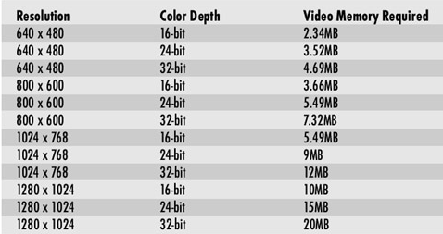
3D Acceleration
Increases amount of RAM required by about 4X because extra RAM is needed for buffers

Slide 15
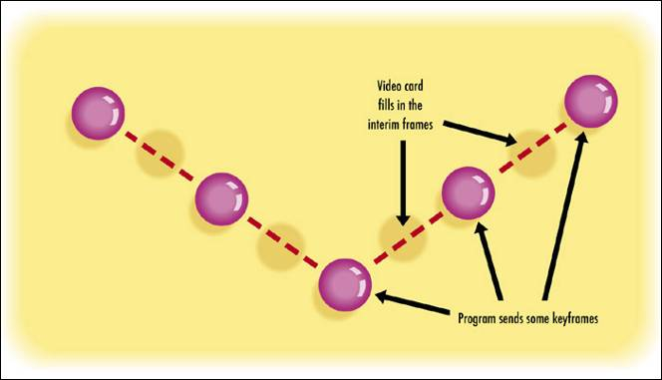
3D Acceleration
Key frames allow video card to help application create smoother animation

Slide 16
Texture/Shading Support
Rasterization: filling in a shape with shading and texture. Some common methods:
  Texture mapping
  Flat shading
  Gourad shading

Slide 17
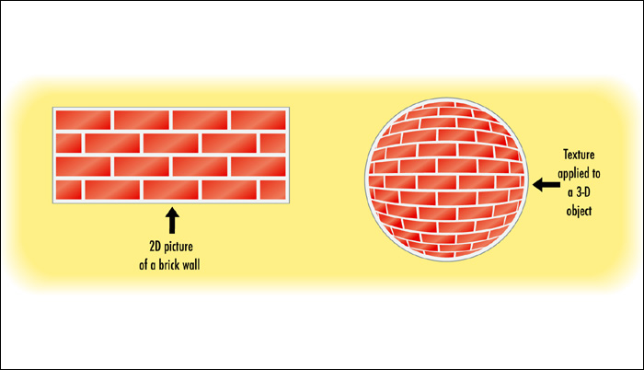
Texture Mapping
Applies a 2D texture bitmap to a 3D object

Slide 18
3D API Support
Application must support same standard that video card supports
Common APIs include:
  OpenGL
  DirectX
  Direct3D
  3Dfx Glide

Slide 19
Other Video Card Features
MPEG-2 Decoding
  Hardware decoding for DVD movies and other videos
TV Out
  Enables a TV to be used as a monitor
TV/Video Capture In
  Enables the PC to record TV or video
Dual Monitor Output
  Enables more than one monitor to be connected

Slide 20
Install a Video Card
Remove old video card if needed
Remove backplate from slot if needed
Insert video card firmly in slot
Secure it with screw or retainer bar
Connect a monitor, and boot

Slide 21
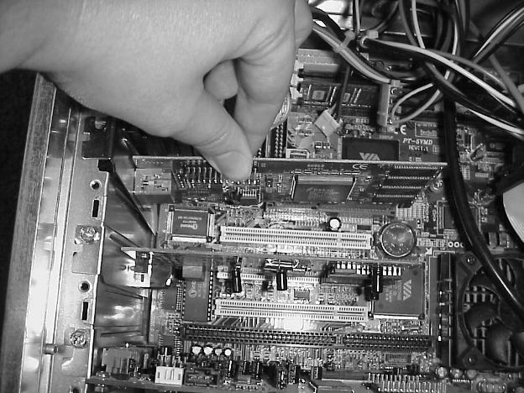
Install a Video Card

Slide 22
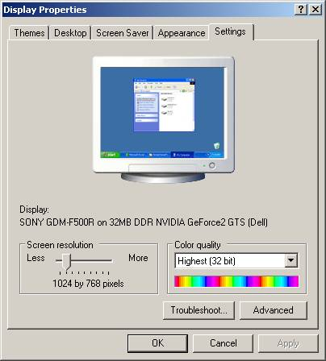
Set Display Properties in Windows
Install correct driver for video card if needed
Right-click the desktop, choose Properties
Change resolution and color depth on Settings tab

Slide 23
Troubleshooting Video Card
Nothing appears on-screen
  Monitor turned off
  Monitor contrast turned down
  Monitor not connected
  PC not powered on
  Defective video card
  Not installed correctly

Slide 24
Troubleshooting Video Card
Screen has a red, blue, or green tint
  Pin broken on monitor or video card connector
  Connector not snugly plugged in
Garbled Windows display
  Bad video driver
  Correct problem in Safe Mode

Slide 25
Troubleshooting Video Card
Vertical stripes on Windows display
  Corrupted video driver
  Physical defect in video card
  Not the monitor’s fault
Windows won’t start except in safe mode
  Bad Windows video driver
  Wrong driver installed for video card

Slide 26
Troubleshooting Video Card
Pictures and colors look bad
  Too low a color depth being used
  Video card not recognized, so it is using standard VGA mode (16 color)
  Install driver for exact model of video card
Certain Applications Crash
  Video driver not up-to-date
  Patch for application required
  New version of DirectX required

